Slide 1


The Fine Tuners
14.11.2023
Presented by M.Cem Akuras

Slide 2

Table of Content
Introduction
01
02
Data Understanding
Data Structure
Column Analysis
Missing Values
Duplicates
Outliers
Data Preparation
03
Handling Missing Values
Identifying and Removing Outliers
04
Summary
Next Steps
05

Slide 3

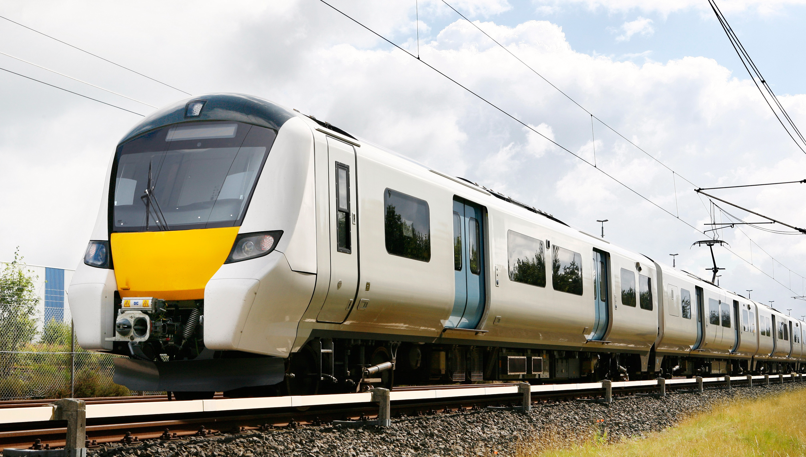
Introduction
Presentation Purpose : Delve into the critical stages of Data Understanding and Data Preparation for our project focused on enhancing Train Maintenance through NLP Analysis of Social Media Tweets.
Effective data understanding and preparation are the keys to ensuring the quality and accuracy of the data we use in our analysis, which is vital for making informed decisions and improving train maintenance.

Slide 4







Data Understanding Data Structure
Data Sources
Data Format
2 different sources
JSON File
Data Quality
Data Size
2,219 Duplicates
3 columns have missing values
16,949 Rows
20 Columns
Data
Data Types
1 Date/Time
4 Categorical
8 Numeric,
1 String
6 Constant
Flat File
Data Organisation

Slide 5
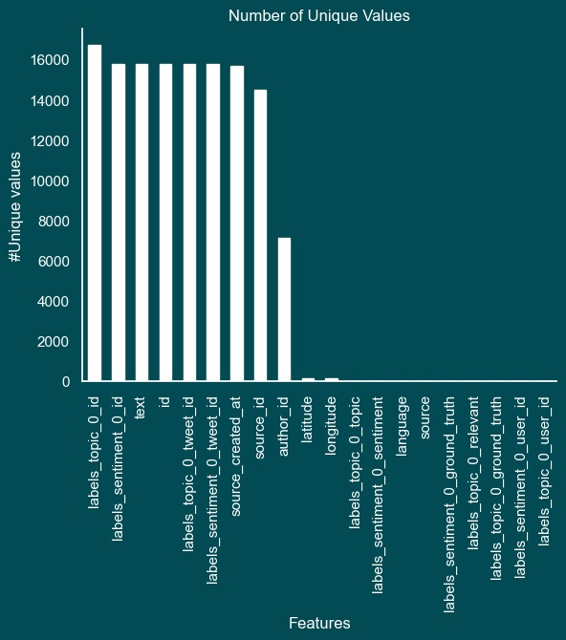
Data Understanding Column Analysis
The dataset size of 16,949 tweets provides a substantial volume for the analysis.
The dataset comprises a variety of columns, including text, timestamps, and other relevant information.
Columns with star which are ‘text’, ‘author_id’, ‘labels_sentiment_0_topic’, ‘source_created_at’ ‘labels_topic_0_topic’ and ‘source’ take center stage in our analysis, signifying our focus.

Slide 6
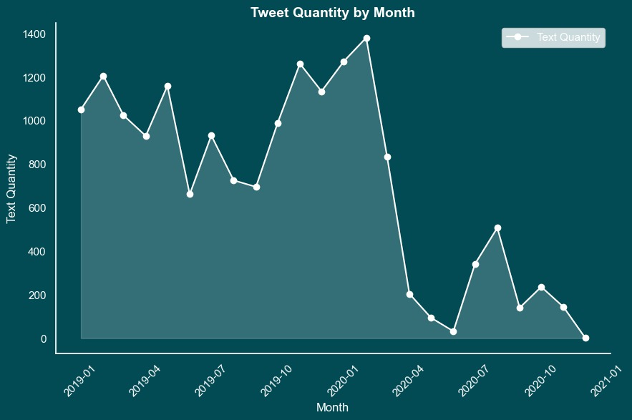
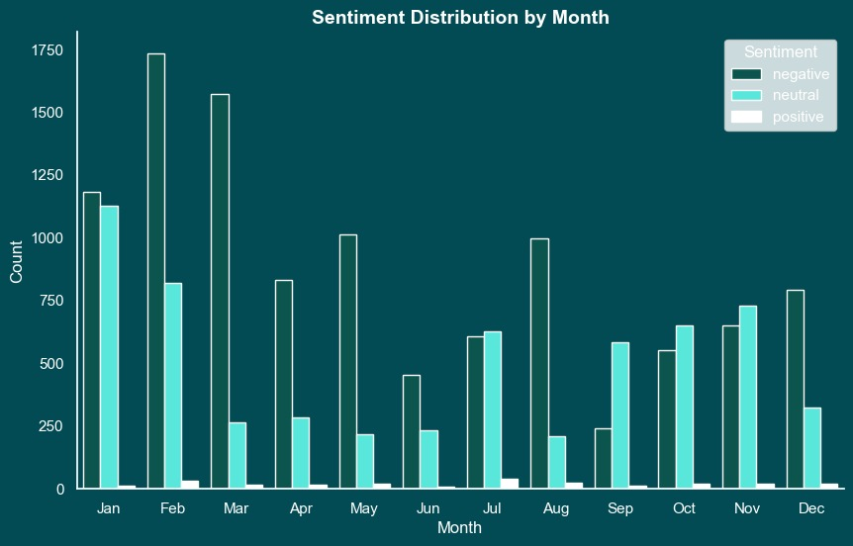
Data Understanding Time
The dataset covers a time interval from the beginning of 2019 to the end of 2020.
In addition to tweet quantity, the sentiment distribution was also examined month by month. This graph provides insights into how sentiments evolved within the dataset over the same time frame.

Slide 7
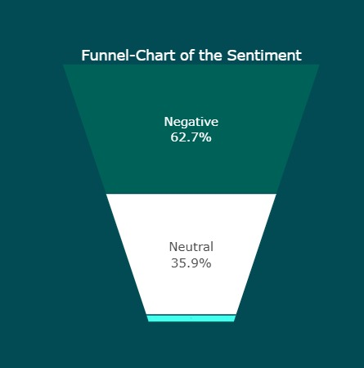
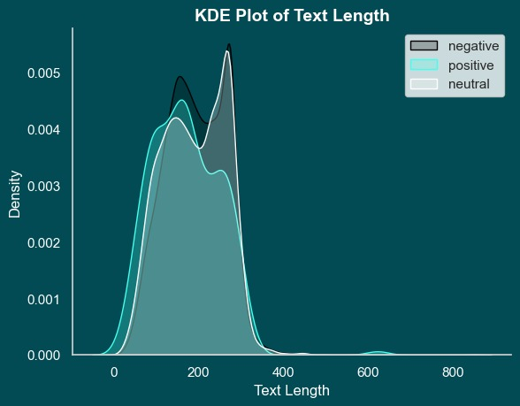
Data Understanding Sentiment
The dataset includes sentiment annotations in the form of a 'Sentiment' column, categorizing tweets into negative, positive, and neutral sentiments.
Our analysis reveals a notable trend where negative sentiments align with longer text posts. This suggests that individuals tend to express anger and frustration through more extensive, detailed, and expressive tweets.
Positive

Slide 8
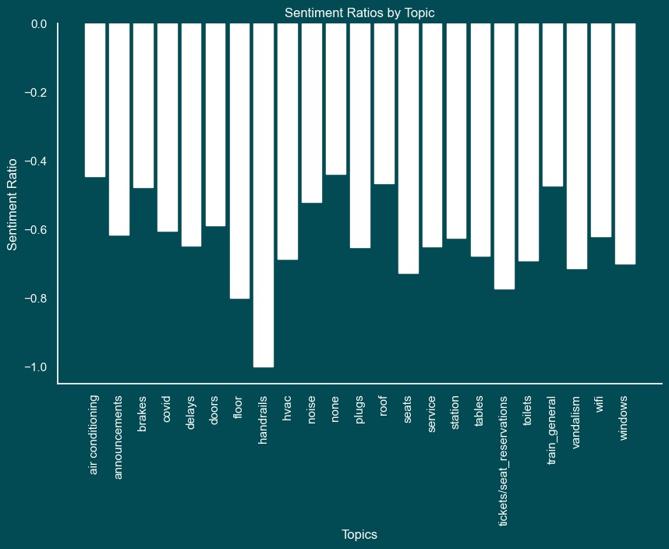
Data Understanding Sentiment
This graph presents the average sentiments (positive, negative, and neutral) for various topics within the dataset, offering insights into how sentiment varies across different topics.

Slide 9
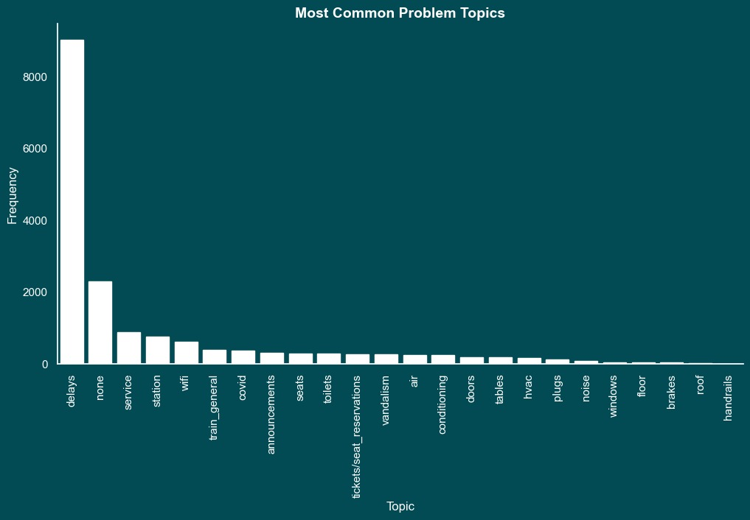
Data Understanding Topic
The dataset includes categorical annotations for tweet topics, allowing us to classify and analyse tweets based on their respective subjects or themes.

Slide 10
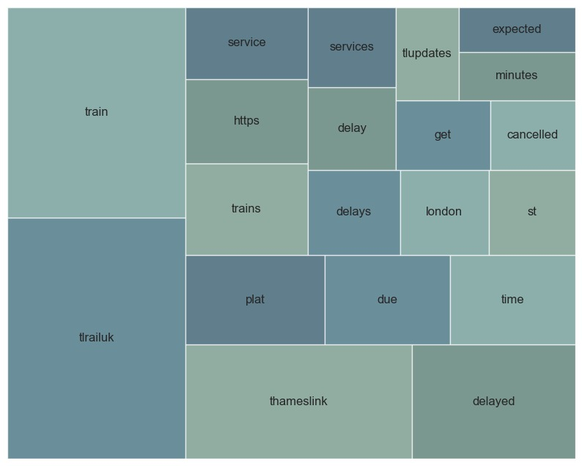
Data Understanding Text
Our analysis also includes a visualization of the most frequently used words within the dataset. This graph highlights the key terms and themes that dominate the conversation, offering valuable insights into the central topics and discussions as observed in social media tweets.
As the most common topic, 'delay' appears on this graph in three variations: 'delay’, 'delays’ and 'delayed’. We will address this redundancy in the data preparation process to ensure accurate and consistent analysis.

Slide 11
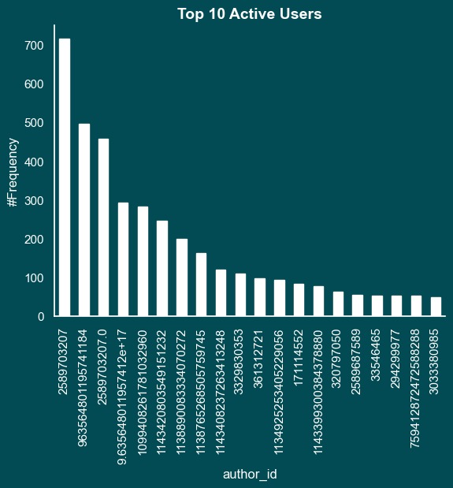
Data Understanding Author ID
This graph showcases the top 10 most active users in our dataset. Notably, users denoted with yellow stars have consistently used the hashtag #TLUpdates, while those with red stars have frequently employed the hashtag #ThameslinkUpdate. These tweets, identified as company communications, provide official updates and communications from the company.

Slide 12
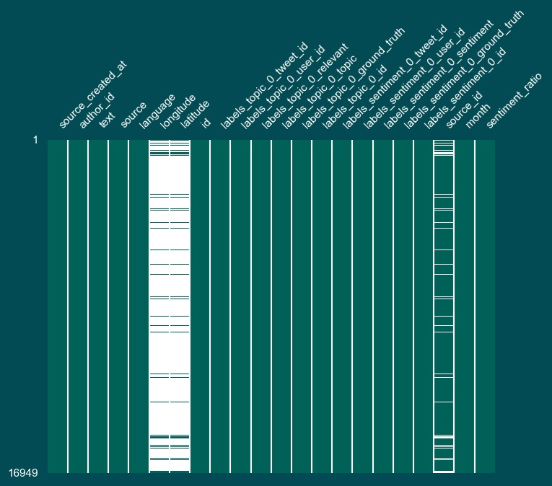
Data Understanding Missing Values
In our dataset, we have identified missing values in three columns: Longitude, Latitude, and Source ID. These missing values are notable in the Longitude and Latitude columns, but they are not conducive to meaningful analysis as they represent GPS coordinates.
Given that the Longitude and Latitude columns contain missing values and do not provide actionable insights for our analysis, we will exclude them from our data processing, ensuring a focus on more relevant features.

Slide 13



Data Understanding Duplicates
We've identified 2,219 duplicate entries, 388 highly similar rows (90% - <100%), and 37 retweets. Identifying and addressing these duplicates is crucial to ensure the integrity of our analysis and insights.
2,219 duplicates
388 similar rows
(90% - <100%)
37 retweet

Slide 14
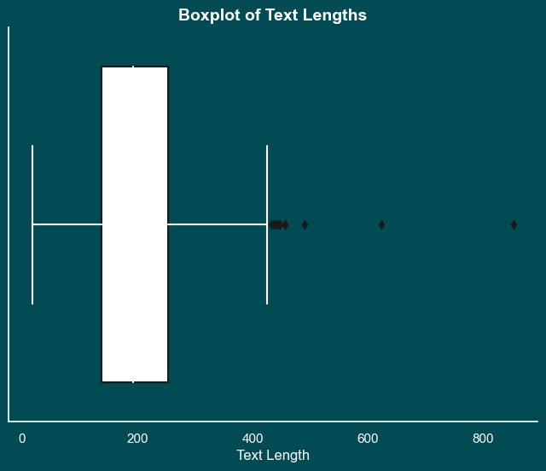
Data Understanding Outliers
The box plot highlights 11 outliers in text length within our dataset, with a maximum value of 400.
xxxxx

Slide 15
Data Preparation Identifying and Removing Outliers
xxxx
xxxx

Slide 16
Summary
xxxxx
xxxxxxx

Slide 17

Next Steps
xxxxx
xxxxxxx

Slide 18
Thank you!

